Slide 1
Support Vector Machines
Kashyap Maddala - Boiler Quant

Slide 2

Support Vector Machine
Support vector machine (SVM) is a machine learning model that finds an optimal hyperplane in some given space (e.g. a line in 2D, plane in 3D, etc) to separate classes.
This model, using various financial techniques and values as predictors, can then predict some output. Here, that output is the relative change in price.

Slide 3
Predictors
Exponential Moving Average
Uses EMA of current day and 5 days prior to determine trend direction.
Volatility
Parkinson volatility determines the variance of the stock returns. Useful for measuring spread.
1
3
2
QQQ ETF Price
The Invesco QQQ price is more correlated with tech company stock prices, making it a useful tool when dealing with tech companies.
4
Volume and RSI
Determines how many shares were traded in a day and whether it’s overbought or oversold.

Slide 4
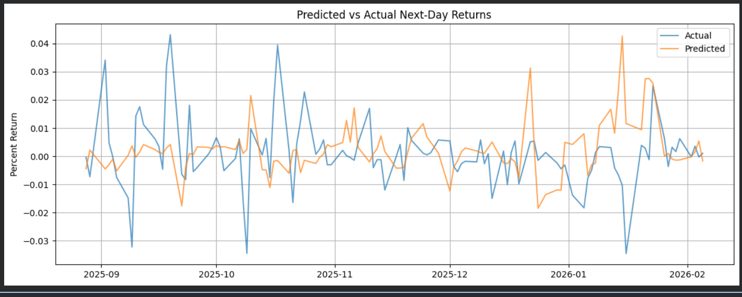
Predictions vs. Actual returns
The model predicted the direction with roughly a 50% accuracy and was mostly inaccurate with the magnitude of the change in returns. This is because ML models are not particularly effective at predicting variance.
While a classifier produced a slightly higher directional accuracy, regression allowed me to pick better signals for backtesting the model.

Slide 5
Backtesting + Statistics
Statistics (tested on AAPL stock ticker):
Total return: 0.32% (profit)
Sharpe ratio: 1.72
Number of trades: 10
Mean absolute error (MAE): 0.0105
Reflection:
This model predicts returns with a much lower variance than actual historical stock data, meaning that something like time series would be more useful because it predicts the actual variance.
Signal Strategy:
Buy for positive predicted return, volatility < 1, and RSI between 35 and 65 (not overbought, not oversold).
Sell for negative predicted return and lower return than previous day.
Notes:
R^2 value is quite misleading given that this model is a regression model and not a classifier (regression models have higher variance).

